Slide 1
Rayat Shikshan Sanstha’s R. B. Narayanrao Borawake College, Shrirampur,
Tal. Shrirampur, Dist. Ahmednagar
Dr. Ganesh V. Lokhande
Class:
F.Y..B.A.
Subject :
General Psychology (G-1)
Topic:
Lateral Thinking (Six Thinking Hats)

Slide 2
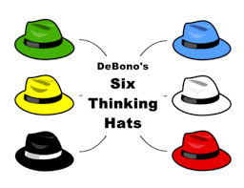
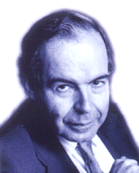
Lateral Thinking (Six Thinking Hats) For Disaster Management

Slide 3
Lateral Thinking For Disaster Management
Lateral thinking concept delivered by Edward de Bono in 1967.
According to Edward de Bono, Lateral Thinking as methods of thinking concerned with changing concepts and perception.
Lateral thinking is a evaluative thinking process.
Lateral thinking process differ than other thinking processes.
Lateral thinking process is one of problem solving method.
Edward D. Bono explain lateral thinking process in six thinking hats techniques
Six Thinking Hats Technique developed by Edward De Bono in 1985

Slide 4
Objectives of Six Thinking Hats?
To Helps us to communicate more effectively.
To Increasing productivity and performance in thinking process.
To generate new ideas and creative think.
Use in groups also individually decision process.
To promotes creative problem solving.
To Increase thoughts and ideas.
To solve problems instant.
To depth thinking process.
To saving time.
To remove ego from decision making.
An important and powerful technique.
It is used to look at decisions from a number of important perspectives.
Various type of thinking.

Slide 5
Six Thinking Hats Technique
Blue Hat
To Control Thinking Process.
To Coordinator of Decision Making
To Determine Goal Setting.
To Control on Other Hats
To Selection of the Topic for Discussion.
To Leadership of Group Member.
To Guidance Other Members in the Group.
To Summary of Group Discussion
Take Final Decisions.

Slide 6
Six Thinking Hats Technique
Red Hat
Symbol of All Emotions.
Symbol of All Feelings.
Symbol of Intuition.
To Hunches to Others Mind.
Try to Understand Reactions of the Others.
Try to Understand Interest, Love of the Others.

Slide 7
Six Thinking Hats Technique
Yellow Hat
Symbol of Optimistic
To Positive Thinking
To Productive Think
Helpful
Helps to Thinking Positively.
To see all the Benefits of the Discussions and Decision.

Slide 8
Six Thinking Hats Technique
Green Hat
To Creative Thinking
To develop new concept for problem solving
To inspiring lateral thinking process
To give opportunities use of all tools of lateral thinking
To develop New Ideas in discussion and decision Process.
To Search New Alternatives

Slide 9
Six Thinking Hats Technique
White Hat
Realistic Symbol
To Objective Thinking
To Attention Present Needs and Problems.
To Attention on Present Topic of Discussion.
To Attention on Planning
To Achieve the More Information.
To Focus on the Data Available.

Slide 10
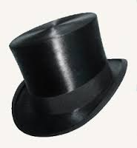
Six Thinking Hats Technique
Black Hat
To Negative Thinking.
To Think Serious
To Search Risk in Decisions
To Careful Thinking
Look at all the Bad Points of the Decision.
To Evaluation of Decisions Negative Views.

Slide 11
Six Thinking Hats Technique

Slide 12
Ref. www. Google.com.in

